Slide 1
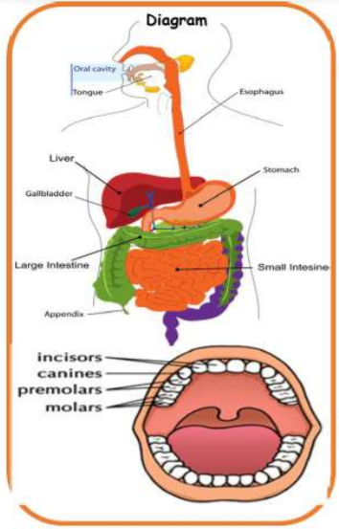
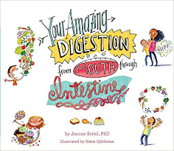
Y
Science Year 4 – Autumn 2 : What happens to the food we eat?
Key diagrams
Key Vocabulary | Definition
salivary gland | The salivary gland contains special enzymes that help digest the starches in your food.
pancreas | The pancreas produces juices called enzymes which helps the body digest food.
intestine | The main function of the small intestine is absorption of nutrients and minerals from food. The major function of the large intestine is to absorb water from the remaining indigestible food.
organ | The skin is the biggest organ of your body. Other organs include your brain, heart, liver, stomach, intestines, pancreas and kidneys, and they are called internal organs.
molars | Molars are the teeth that are used for chewing and grinding our food.
canine incisors | Canine are the teeth used for ripping and tearing food. Incisors are the teeth used for cutting.
What do I need to know from previous units?
Humans, need the right types and amount of nutrition, and that they cannot make their own food; they get nutrition from what they eat. | Humans and some other animals have skeletons and muscles for support, protection and movement.
What will I know by the end of the unit?
The process of digestion is the food passes through the body with the nutrients being extracted and the waste products excreted. | The main job for the small intestine is to absorb nutrients and minerals from food. In fact, 90% of food absorption takes place here, making it our main digestion location.
The oesophagus is the food highway that takes your dinner from your mouth down into your stomach so that digestion can begin. | The outside of our teeth are covered with enamel and the inside have blood vessels and nerves
The stomach is filled with powerful acids that break down the food into smaller pieces. It also lets us know when we are hungry. | The front teeth are called incisors, the four sharp teeth are called canines, the teeth at the back are called molars.
The liver creates different enzymes to help process food nutrients that are collected in the small intestine. | The energy for a food chain initially comes from the Sun which is absorbed and turned into energy by plants which are called Producers.
The gallbladder is a storage unit for all of the bile and enzymes created by the liver. It stores them until they are needed for digestion. | The first consumer in a food chain is called a primary consumer, the second is called a secondary consumer and above it is a tertiary consumer.
Key Texts

